Slide 1
SSIS in ADF
BY
Sridhar SHANKAR

Slide 2
An Quick Intro to SSIS
SSIS stands for SQL Server Integration Services
We use Integration Services to solve complex business problems by copying or downloading files, loading data warehouses, cleansing and mining data, and managing SQL Server objects and data.
Integration Services can extract and transform data from a wide variety of sources such as XML data files, flat files, and relational data sources, and then load the data into one or more destinations.
You can use the graphical Integration Services tools to create solutions without writing a single line of code. You can also program the extensive Integration Services object model to create packages programmatically and code custom tasks and other package objects.

Slide 3

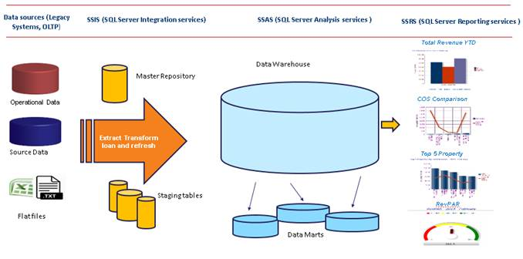
MSBI Architecture

Slide 4
SSIS in Azure
Now we can deploy, run, and manage SSIS projects and packages in the SSIS Catalog (SSISDB) on Azure SQL Database or SQL Database Managed Instance with familiar tools such as SQL Server Management Studio (SSMS).
When you provision an instance of SQL Database to host SSISDB, the Azure Feature Pack for SSIS and the Access Redistributable are also installed. These components provide connectivity to various Azure data sources and to Excel and Access files, in addition to the data sources supported by the built-in components.
Integration Services packages reside in projects. To create and work with Integration Services projects, you must install the SQL Server Data Tools (SSDT) environment.
In SQL Server Data Tools (SSDT), an Integration Services project stores and groups the files that are related to the package. For example, a project includes the files that are required to create a specific extract, transfer, and load (ETL) solution.

Slide 5
Continue…
SSIS Designer has five permanent tabs: one each for building package control flow, data flows, parameters, and event handlers, and one tab for viewing the contents of a package. At run time a sixth tab appears that shows the execution progress of a package while it is running and the execution results after it finishes.
Moving your on-premises SSIS workloads to Azure has the following potential benefits:
Reduce operational costs and reduce the burden of managing infrastructure that you have when you run SSIS on-premises or on Azure virtual machines.
Increase high availability with the ability to specify multiple nodes per cluster, as well as the high availability features of Azure and of Azure SQL Database.
Increase scalability with the ability to specify multiple cores per node (scale up) and multiple nodes per cluster (scale out).

Slide 6
ADF
Azure Data Factory is the platform for these kinds of scenarios. It is a cloud-based data integration service that allows you to create data-driven workflows in the cloud that orchestrate and automate data movement and data transformation.
This is how it works.
Without Data Factory, enterprises must build custom data movement components or write custom services to integrate these data sources and processing. It is expensive and hard to integrate and maintain such systems. These systems also often lack the enterprise grade monitoring, alerting, and controls that a fully managed service can offer.

Slide 7
Continue…
Azure Data Factory is composed of four key components. 1) Pipeline 2) Activity 3) Datasets 4) Linked services
A data factory can have one or more pipelines. A pipeline is a group of activities. Together, the activities in a pipeline perform a task.
A pipeline can have one or more activities. Activities define the actions to perform on your data. Data Factory supports two types of activities: data movement activities and data transformation activities.
An activity takes zero or more datasets as inputs and one or more datasets as outputs. Datasets represent data structures within the data stores. These structures point to or reference the data you want to use in your activities (such as inputs or outputs).
Linked services are much like connection strings, which define the connection information that's needed for Data Factory to connect to external resources.

Slide 8
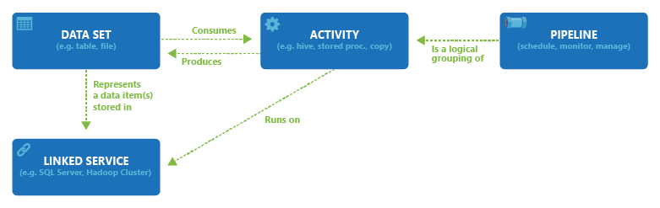
Relationship between Data Factory entities

Slide 9
Prerequisites
Azure subscription. If you don't have an Azure subscription, create a free account before you begin.
Azure SQL Database server. If you don't already have a database server, create one in the Azure portal before you get started. Azure Data Factory creates the SSIS Catalog (SSISDB database) on this database server. We recommend that you create the database server in the same Azure region as the integration runtime. This configuration lets the integration runtime write execution logs to the SSISDB database without crossing Azure regions.
Based on the selected database server, SSISDB can be created on your behalf as a single database, part of an elastic pool, or in a Managed Instance and accessible in public network or by joining a virtual network. If you use Azure SQL Database with virtual network service endpoints/Managed Instance to host SSISDB or require access to on-premises data, you need to join your Azure-SSIS IR to a virtual network, see Create Azure-SSIS IR in a virtual network.

Slide 10
Continue…
Confirm that the Allow access to Azure services setting is enabled for the database server. This is not applicable when you use Azure SQL Database with virtual network service endpoints/Managed Instance to host SSISDB. For more information, see Secure your Azure SQL database. To enable this setting by using PowerShell, see New-AzureRmSqlServerFirewallRule.
Add the IP address of the client machine, or a range of IP addresses that includes the IP address of client machine, to the client IP address list in the firewall settings for the database server. For more information, see Azure SQL Database server-level and database-level firewall rules.
You can connect to the database server using SQL authentication with your server admin credentials or Azure Active Directory (AAD) authentication with the managed identity for your Azure Data Factory (ADF). For the latter, you need to add the managed identity for your ADF into an AAD group with access permissions to the database server, see Create Azure-SSIS IR with AAD authentication.

Slide 11
Azure Hybrid
Azure Hybrid Benefit for SQL Server is an offer designed to help you gain more value from your SQL Server licences on Azure SQL Server Integration Services. Customers with active Software Assurance on Enterprise and Standard edition per-core licences are eligible for the offer if they choose to move these licences to the cloud. Azure Hybrid Benefit for SQL Server is not restricted to any specific licensing programme, but you must have active Software Assurance coverage.
You can activate Azure Hybrid Benefit via the Azure portal by attesting you have sufficient active licences with Software Assurance.
To facilitate migration, Microsoft provides a 180-day grace period for using licences both on-premises and in the cloud. After this period, licences must be used either on-premises or in the cloud.
You need active Software Assurance to use Azure Hybrid Benefit for SQL Server. If your Software Assurance expires and you do not renew it, you will be moved to the licence-included pricing of the relevant SKU.

Slide 12
SSIS Standard A-series V2 VM
INSTANCE | CORES | RAM | TEMPORARY STORAGE | LICENCE INCLUDED PRICE PER NODE | PRICE WITH AZURE HYBRID BENEFIT PER NODE (% SAVINGS)
A4 V2 | 4 | 8.00 GiB | 40 GiB | ₹55.51/hour | ₹29.73/hour (~46%)
A8 V2 | 8 | 16.00 GiB | 80 GiB | ₹114.01/hour | ₹62.45/hour (~45%)

Slide 13
SSIS Enterprise A-series V2 VM
INSTANCE | CORES | RAM | TEMPORARY STORAGE | LICENCE INCLUDED PRICE PER NODE | PRICE WITH AZURE HYBRID BENEFIT PER NODE (% SAVINGS)
A4 V2 | 4 | 8.00 GiB | 40 GiB | ₹126.40/hour | ₹29.73/hour (~76%)
A8 V2 | 8 | 16.00 GiB | 80 GiB | ₹255.78/hour | ₹62.45/hour (~76%)

Slide 14
References
For cost related information please check https://azure.microsoft.com/en-in/pricing/details/data-factory/ssis/
For ADF, please check https://docs.microsoft.com/en-us/azure/data-factory/v1/data-factory-scheduling-and-execution
For SSIS, please check https://www.tutorialgateway.org/how-to-learn-ssis-in-28-days/

